Slide 1


Software Design & System Design
Communication Between Components
Otávio Santana, Founder
otavio@os.expert

Slide 2
Introduction
Topics on this class
Synchronous APIs (REST, gRPC)
Asynchronous communication with queues and message brokers (Kafka, RabbitMQ)
Robust interface design for integration
High Availability and Fault Tolerance
Resilient projects with Circuit Breakers and retries
Replication and failover strategies
Tools for monitoring and automatic recovery (auto-healing)

Slide 3
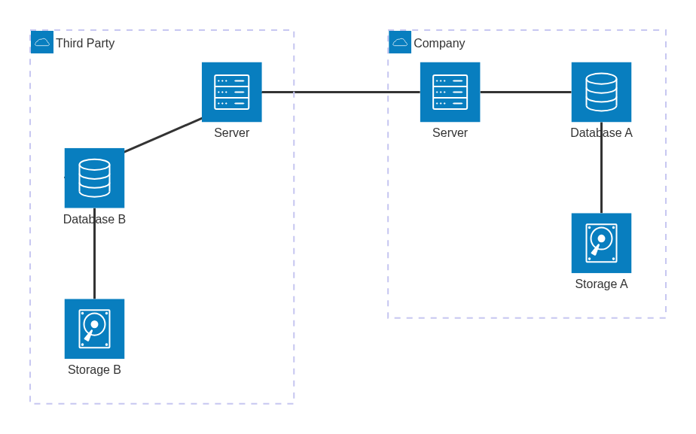
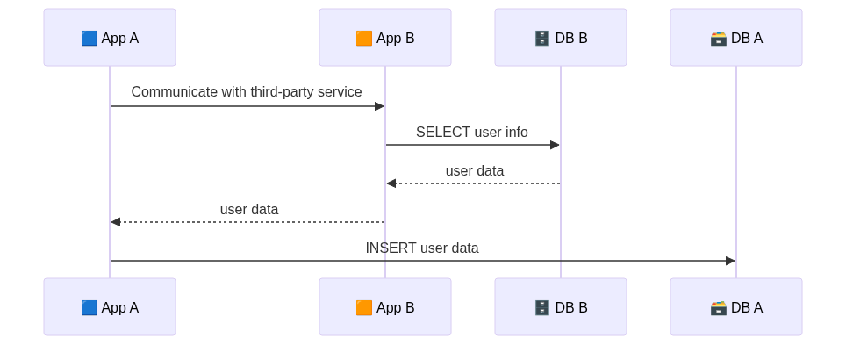
Communication Between Components
Building systems that talk
Synchronous — Real-time request-response (e.g., REST, gRPC)
Asynchronous — Event or message-driven (e.g., Kafka, RabbitMQ)
Notes:
Object
Heritage
Polymorphism
Encapsulation
Types
Database Normalization
Denormalization
Structure

Slide 4
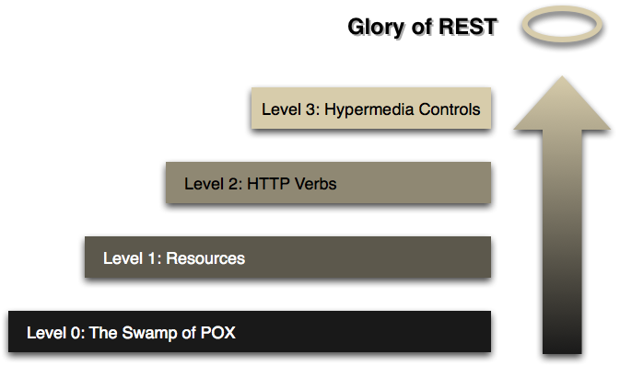
Synchronous Communication with HTTP
Simple, Documented, and Widely Adopted
🌍 Each request is self-contained
📄 Text-based: Uses formats like JSON or XML
📘 Self-documented: With OpenAPI (formerly Swagger)
🌐 Public APIs (Stripe, GitHub, AWS, etc.) 🧾 Inter-organization communication in B2B integrations 🛠️ Internal microservices with minimal tooling overhead
Notes:
Object
Heritage
Polymorphism
Encapsulation
Types
Database Normalization
Denormalization
Structure

Slide 5
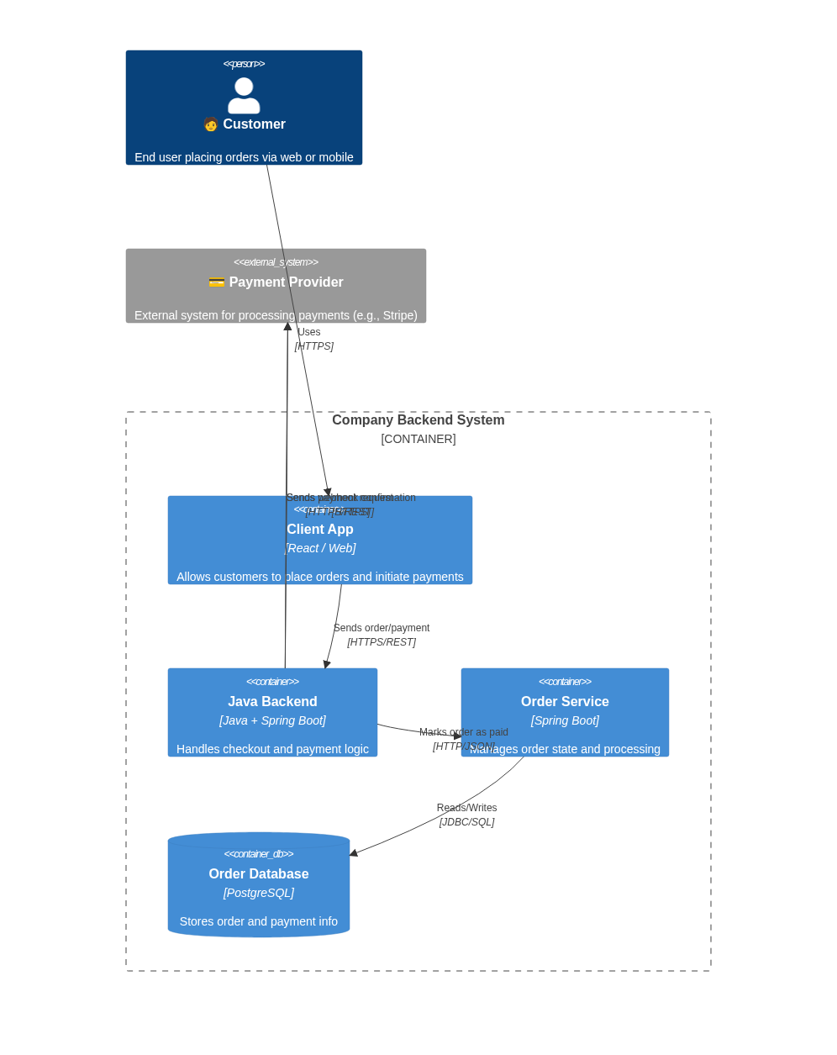
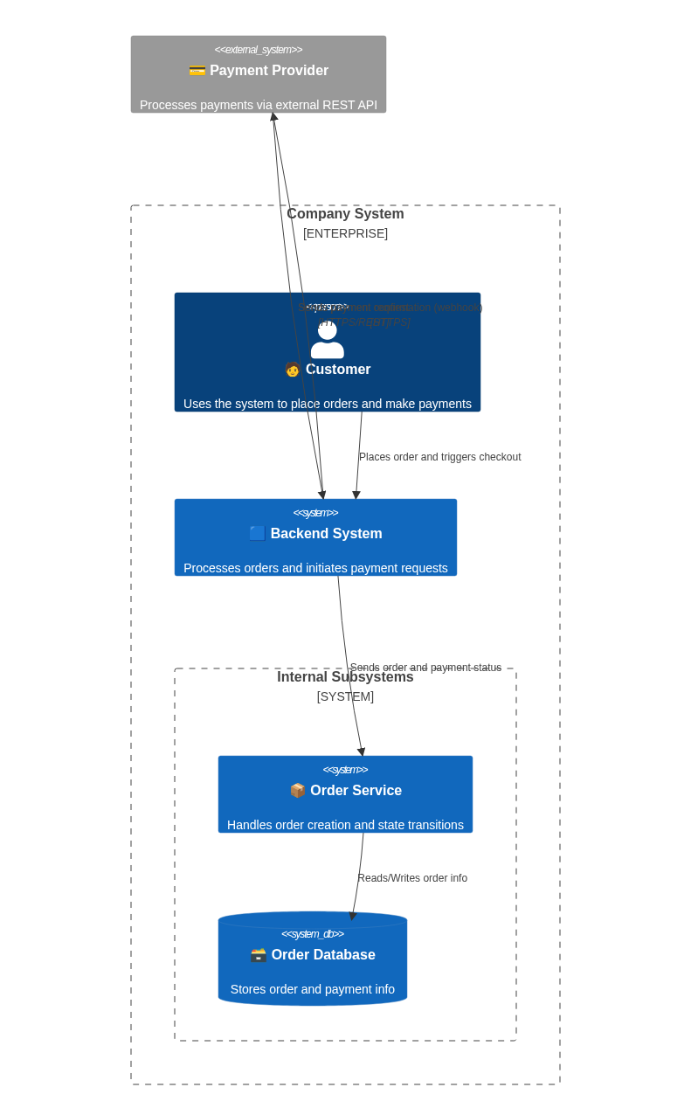
Practical REST Example – Payment Integration
How Applications Talk to Payment Providers
Notes:
Object
Heritage
Polymorphism
Encapsulation
Types
Database Normalization
Denormalization
Structure

Slide 6
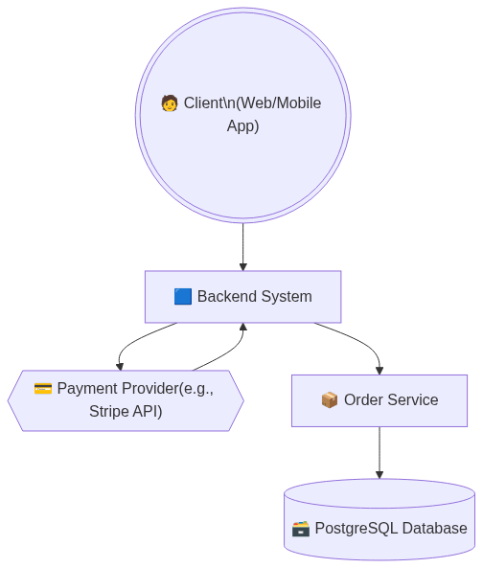
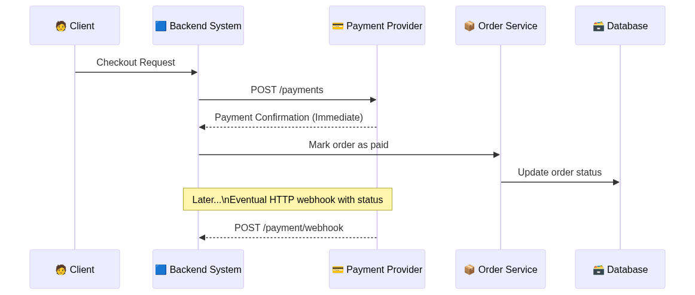
Practical REST Example – Payment Integration
How Applications Talk to Payment Providers
Notes:
Object
Heritage
Polymorphism
Encapsulation
Types
Database Normalization
Denormalization
Structure

Slide 7
gRPC – High-Performance Remote Communication
Fast, Typed, Contract-Driven Service-to-Service Calls
🎯 When to Use
Internal microservices where performance and stability are key
Systems requiring streaming or low-latency comms
Teams that prefer strict contracts between components
⚡ High performance via binary + HTTP/2 multiplexing
🔒 Contract-based with .proto definitions
🧩 Bi-directional streaming and real-time support
🌐 Language-agnostic (Java, Go, Python, etc.)
Notes:
Object
Heritage
Polymorphism
Encapsulation
Types
Database Normalization
Denormalization
Structure

Slide 8
gRPC – High-Performance Remote Communication
Fast, Typed, Contract-Driven Service-to-Service Calls
🎯 When to Use
Internal microservices where performance and stability are key
Systems requiring streaming or low-latency comms
Teams that prefer strict contracts between components
⚡ High performance via binary + HTTP/2 multiplexing
🔒 Contract-based with .proto definitions
🧩 Bi-directional streaming and real-time support
🌐 Language-agnostic (Java, Go, Python, etc.)
Notes:
Object
Heritage
Polymorphism
Encapsulation
Types
Database Normalization
Denormalization
Structure

Slide 9
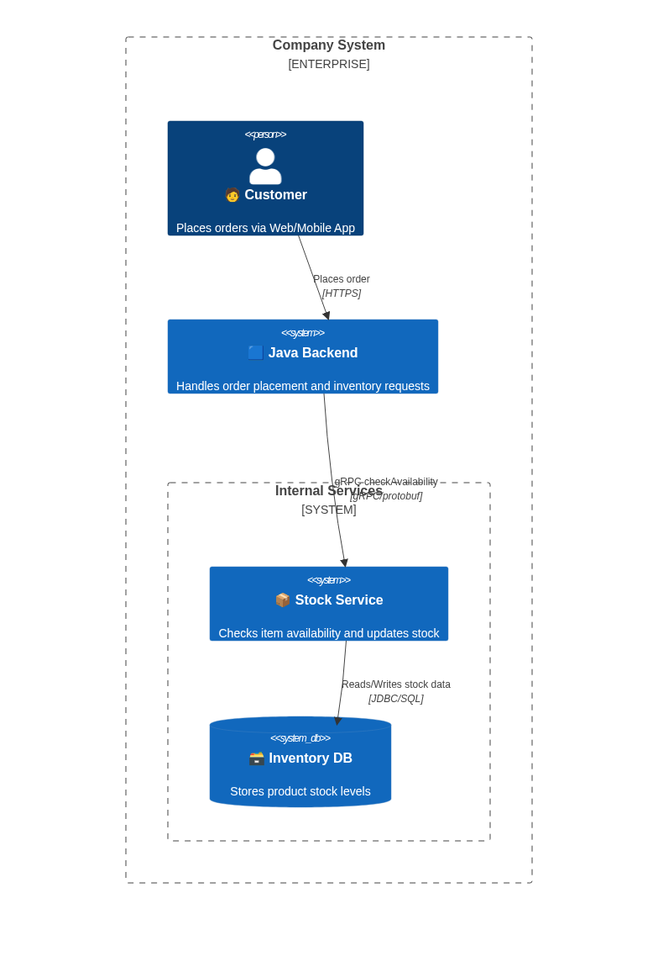
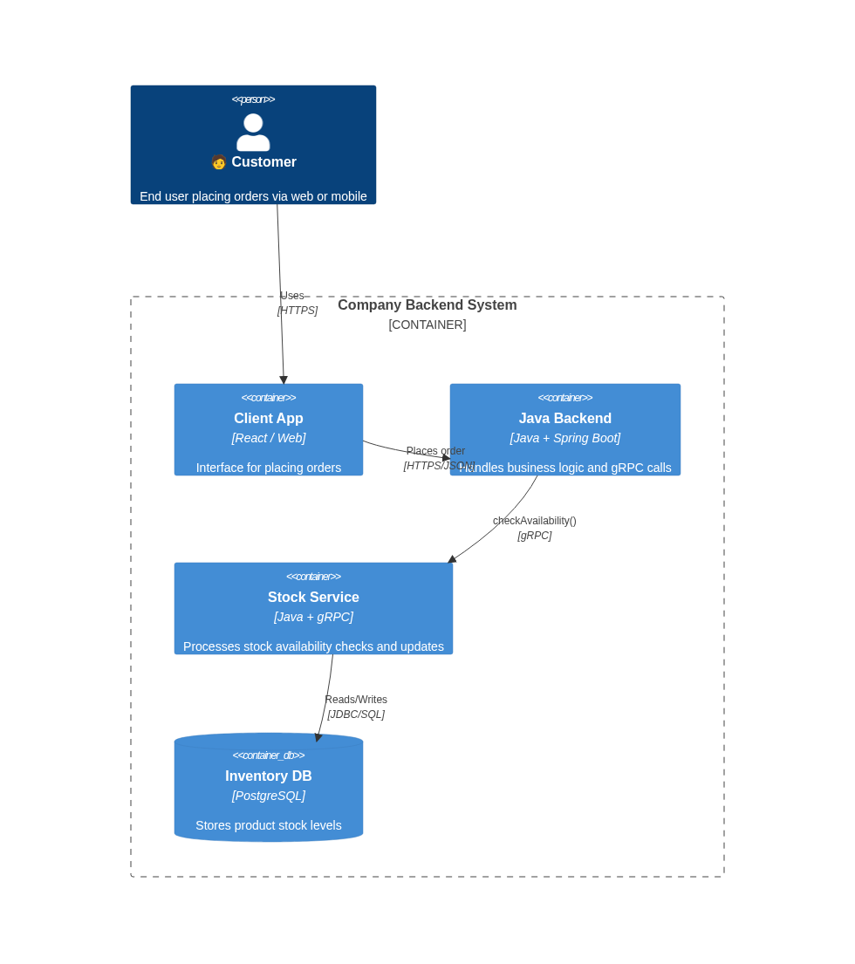
Practical REST Example – Stock
How Applications Talk to Payment Providers
Notes:
Object
Heritage
Polymorphism
Encapsulation
Types
Database Normalization
Denormalization
Structure

Slide 10
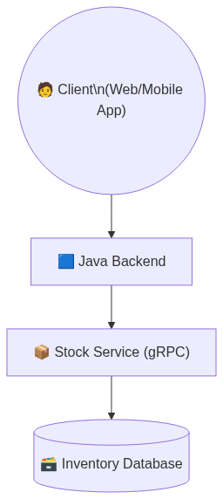
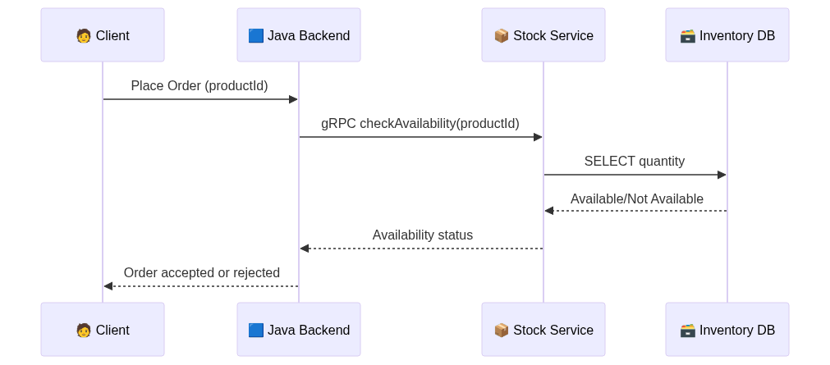
Practical REST Example – Stock
How Applications Talk to Payment Providers
Notes:
Object
Heritage
Polymorphism
Encapsulation
Types
Database Normalization
Denormalization
Structure

Slide 11
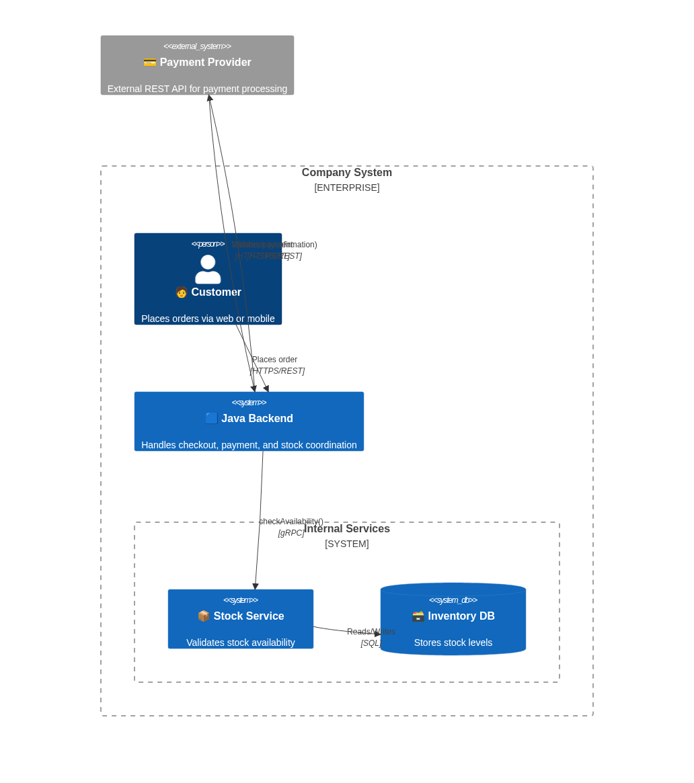
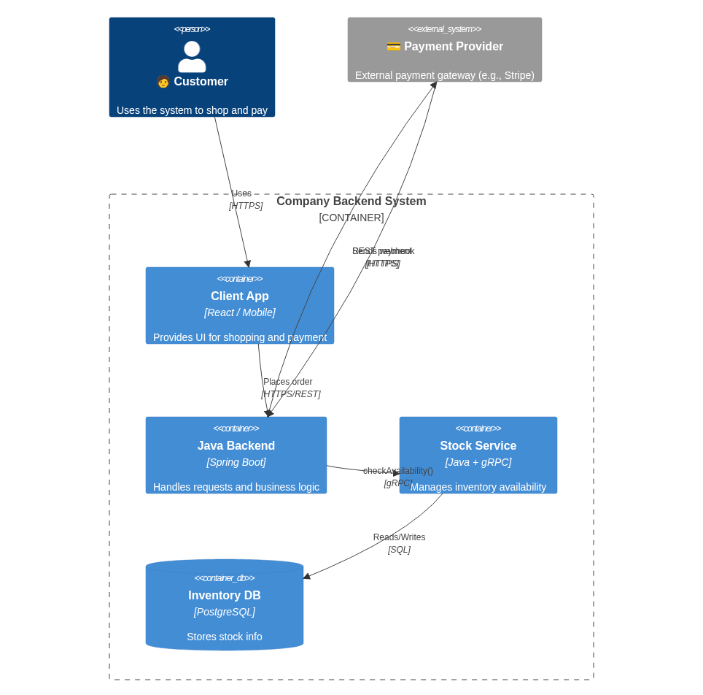
When REST and gRPC Work Together
Mixing Protocols to Optimize Communication Across Boundaries
Notes:
Object
Heritage
Polymorphism
Encapsulation
Types
Database Normalization
Denormalization
Structure

Slide 12
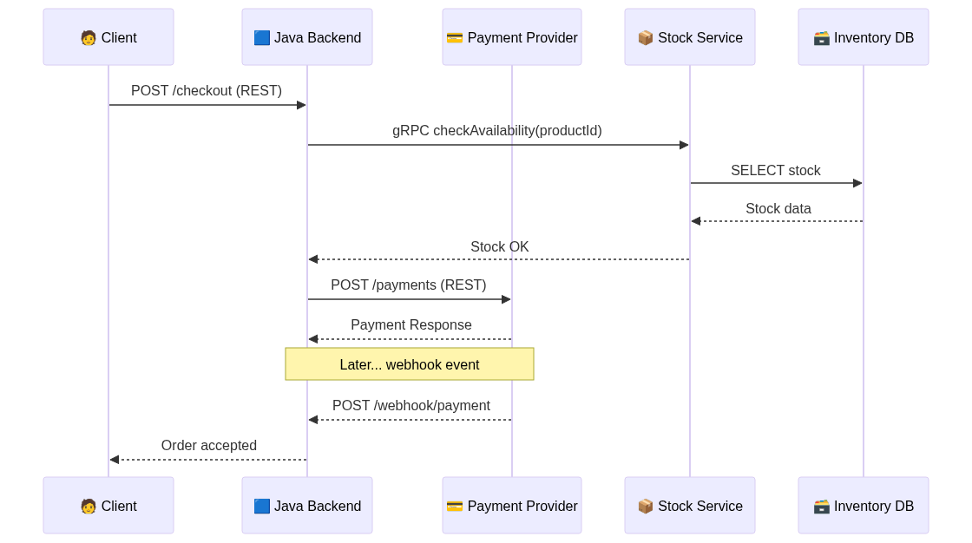
When REST and gRPC Work Together
Mixing Protocols to Optimize Communication Across Boundaries
Notes:
Object
Heritage
Polymorphism
Encapsulation
Types
Database Normalization
Denormalization
Structure

Slide 13
Asynchronous Communication with Queues and Message Brokers
Decoupling Systems for Scalability and Resilience
✅ Loose coupling
✅ Failure isolation (retries, dead-letter queues)
✅ Load buffering
✅ Parallel processing
📬 Decouple producers and consumers
⏳ Process at different speeds
🛠️ Increase resilience and scalability
⚙️ Handle event-driven or batch workflows
Notes:
Object
Heritage
Polymorphism
Encapsulation
Types
Database Normalization
Denormalization
Structure

Slide 14
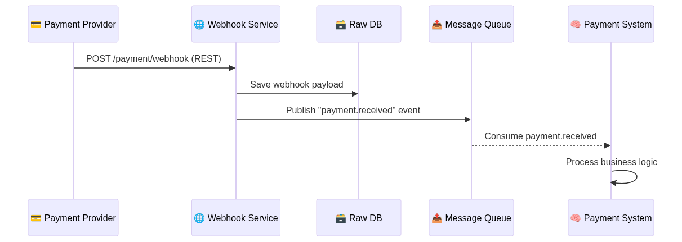
Asynchronous Communication with Queues and Message Brokers
Decoupling Systems for Scalability and Resilience
Notes:
Object
Heritage
Polymorphism
Encapsulation
Types
Database Normalization
Denormalization
Structure

Slide 15
Robust Interface Design for Integration
Designing APIs and Contracts That Are Clear, Durable, and Evolvable
Principle | Description
📄 Clear Contracts | Use OpenAPI/Swagger or .proto to document exactly what is expected
🚦 Validation Rules | Enforce input/output formats, types, ranges
🛡️ Versioning Strategy | Always version external APIs (/v1/...)
🔁 Idempotency Support | Make endpoints safe to retry (PUT, idempotency-key headers)
🪪 Authentication & Authorization | Design with security and scopes in mind
🧪 Testable Interfaces | Provide mocks/stubs for partner testing
📊 Observability | Log, trace, and monitor interactions for reliability
Notes:
Object
Heritage
Polymorphism
Encapsulation
Types
Database Normalization
Denormalization
Structure

Slide 16
High Availability & Fault Tolerance
Designing Systems That Survive Failures Gracefully
Pattern | Purpose
♻️ Retries + Backoff | Retry failed calls with delays
🚪 Circuit Breaker | Prevent overloading failing services
🌐 Load Balancers | Distribute traffic across healthy instances
🧍 Redundancy | Multiple replicas to avoid single points of failure
📡 Failover Strategies | Switch to backup instances/services
🔎 Health Checks | Detect failing components
🔄 Auto-healing | Restart or replace unhealthy nodes
Notes:
🔍 Tools
Resilience4j, Hystrix (Java)
Kubernetes probes + self-healing
NGINX / AWS ALB for load balancing
Monitoring + alerting: Prometheus, Grafana, ELK

Slide 17
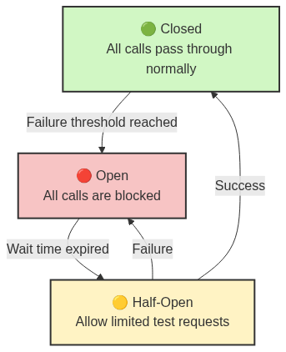
Resilient Projects with Circuit Breakers & Retries
Prevent Cascading Failures and Handle Instability Gracefully
State | Behavior
🟢 Closed | Requests flow normally
🔴 Open | Calls are blocked immediately (to prevent overload)
🟡 Half-Open | Test a few requests to see if service has recovered
Notes:
🔍 Tools
Resilience4j, Hystrix (Java)
Kubernetes probes + self-healing
NGINX / AWS ALB for load balancing
Monitoring + alerting: Prometheus, Grafana, ELK

Slide 18
Replication & Failover Strategies
Keeping Data and Services Available Across Crashes
🧩 Data is not lost if a node crashes
🚀 Systems stay available and performant
🔀 Load can be distributed across replicas
🔄 PostgreSQL streaming replication
☁️ Cloud DBs (e.g., Aurora Multi-AZ, Cosmos DB)
🧭 Kubernetes + Readiness/Liveness probes
🔄 DNS-based failover, Anycast IPs
Strategy | Behavior
🕵️ Passive Failover | Standby node becomes active on failure
🔁 Active-Active | All nodes serve traffic; load balanced
🧠 Health Checks | System detects unhealthy nodes and routes traffic away
⚙️ Orchestration | Tools like Kubernetes automate failover and restart (self-healing)
Notes:
🔍 Tools
Resilience4j, Hystrix (Java)
Kubernetes probes + self-healing
NGINX / AWS ALB for load balancing
Monitoring + alerting: Prometheus, Grafana, ELK

Slide 19
Tools for Monitoring and Automatic Recovery (Auto-Healing)
Detect, Diagnose, and Recover Before Users Even Notice
Layer | What to Monitor | Example Tools
📊 Metrics | CPU, memory, latency, throughput | Prometheus, Grafana
📈 Logs | Error traces, business events | ELK Stack (Elasticsearch, Logstash, Kibana), Loki
📡 Traces | Request flow across services | OpenTelemetry, Jaeger
🧪 Health | Readiness and liveness of services | Kubernetes Probes
Notes:
🔍 Tools
Resilience4j, Hystrix (Java)
Kubernetes probes + self-healing
NGINX / AWS ALB for load balancing
Monitoring + alerting: Prometheus, Grafana, ELK

Slide 20
Tools for Monitoring and Automatic Recovery (Auto-Healing)
Detect, Diagnose, and Recover Before Users Even Notice
Strategy | Description
🚑 Self-Restart | Restart crashed containers via orchestrator
📦 Pod Replacement | Replace failed pods in Kubernetes
🧠 Replica Recovery | Auto-promote replica in database failover
🔄 Auto-scaling | Add/remove instances based on load

